Slide 1
Unit 9: A first-aid course
Lesson 1: Getting started + Listen and read

Slide 2
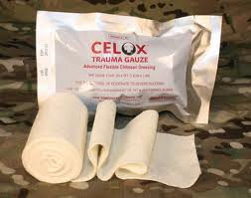
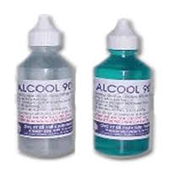
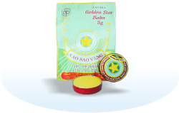
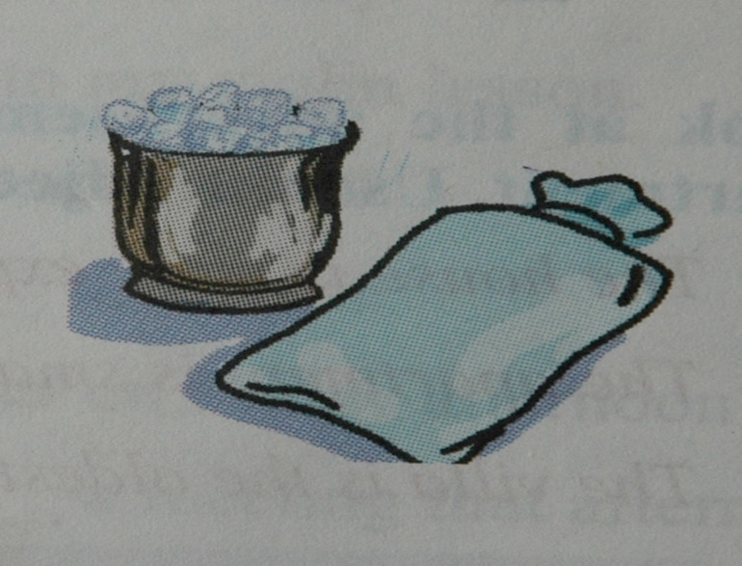
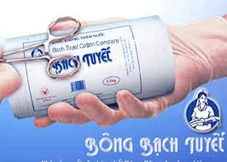
bandage
alcohol
medicated oil
ice
water pack
What are they?
cotton balls

Slide 3
Unit 9: A first-aid course
Lesson 1: Getting started + Listen and read
I/ Getting started
* Things may be necessary for first aid
handkerchief -cotton balls
bandage -alcohol
ice bag -tiger balm
Discuss: Ask your partners
What happened?
What would you do and what do you need for the first aid?

Slide 4
Unit 9: A first- aid course
Lesson 1: Getting Started & Listen and read
Match the situations with the right pictures

Slide 5
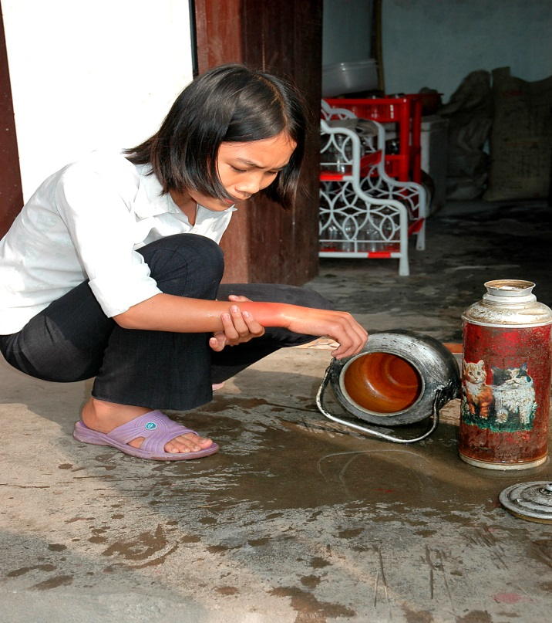
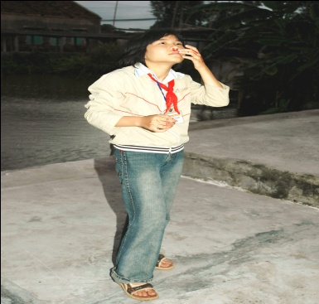
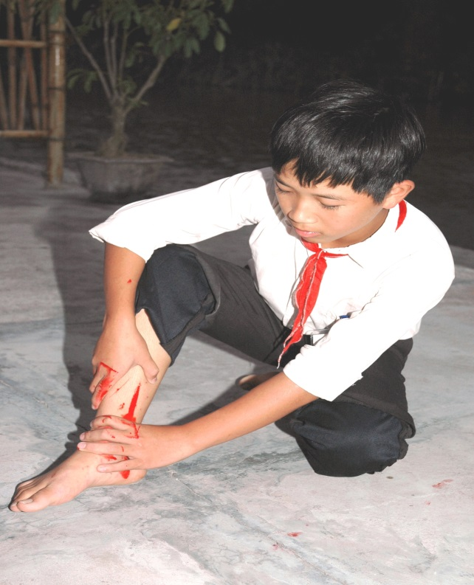
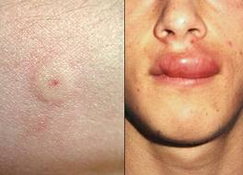
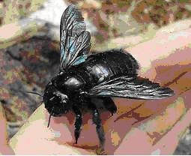
Match the situations with the right pictures
b
1. A girl has a
burn on her arm
2. A boy has a
bee sting
a
3. A girl has a
nose bleed
4. A boy has a bad
cut on his leg
c
d

Slide 6
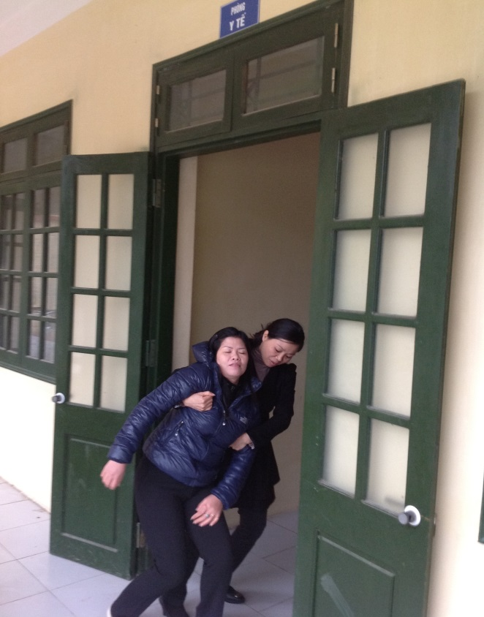
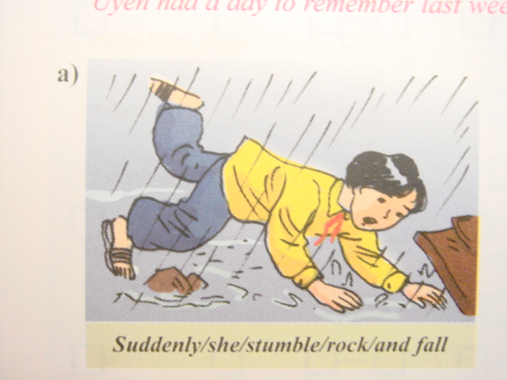
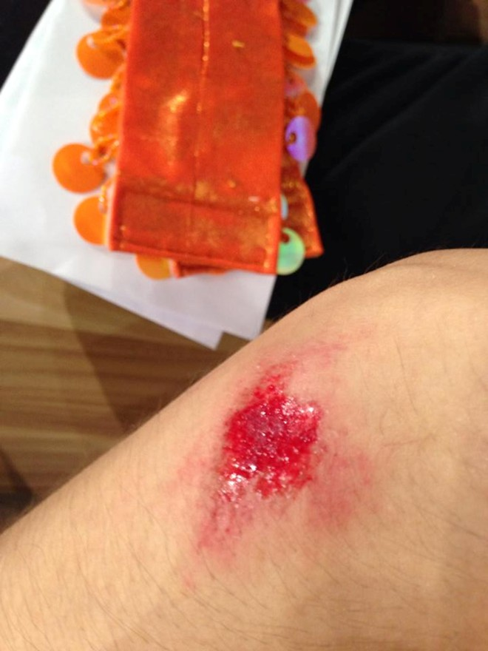
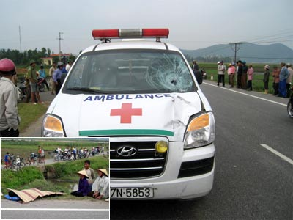
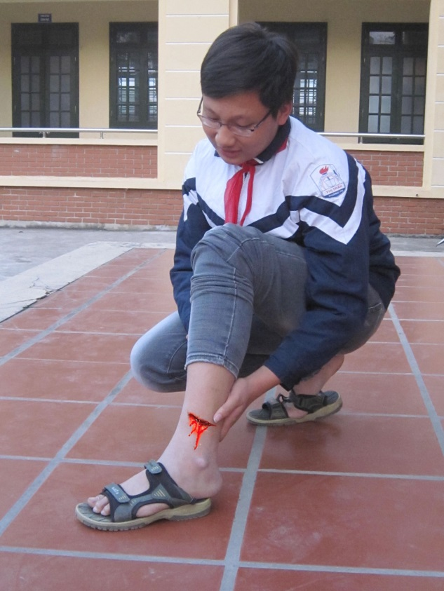
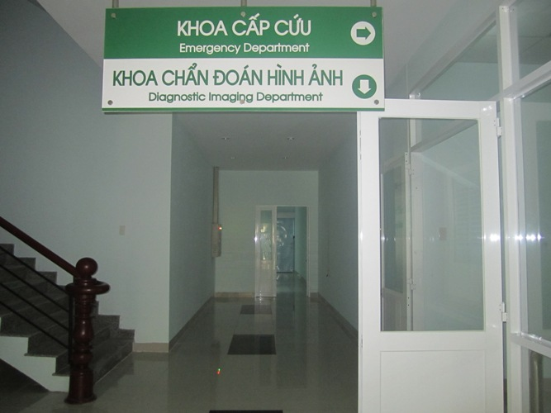
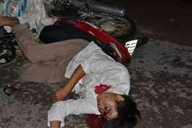
Unit 9: A first- aid course
Lesson 1: Getting Started & Listen and read
Newwords:
- an ambulance (n):
xe cứu thương
- an emergency (n):
sự khẩn cấp
><
- unconscious (adj)
conscious (adj)
(bất tỉnh)
(tỉnh táo)
- to bleed (v):
chảy máu
- wound (n):
Vết thương
- fall off (n):
ngã, rơi xuống
- promise (v):
hứa

Slide 7
Unit 9: A first- aid course
Lesson 1: Getting Started & Listen and read
Nurse :
Lan :
Nurse :
Lan :
Nurse :
Lan :
Nurse :
Lan :
Nurse :
Lan :
Nurse :
Lan :
I/ Getting started :
II/ Listen and read :
Listen to the tape and open your books

Slide 8
Unit 9: A first- aid course
Lesson 1: Getting Started & Listen and read
Nurse :
Lan :
Nurse :
Lan :
Nurse :
Lan :
Nurse :
Lan :
Nurse :
Lan :
Nurse :
Lan :
Bach Mai hospital.
This is an emergency. Please send an ambulance to Quang Trung School. A …………….is hurt.
Calm down.Can you tell me what happed ?
She fell off her bike and hit her ………on the road.
Is she conscious ?
Yes, but she had a bad cut on her head. It’s bleeding quite badly.
Try to ……… the bleeding. Use a towel or a handkerchief to cover the wound. Then put pressure on it. Hold it tight.
………..you hurry?
Of course. What is the address of the school?
Ngo Si Liem Lane. It’s between Quang Trung Street and tran Hung Dao Street.
The ambulance will be there in about …….….minutes. She mustn’t asleep.
All right. I promise I’ll keep her awake.
I/ Getting started :
II/ Listen and read :
student
Listen and complete the dialogue (close your books)
head
stop
Will
ten

Slide 9
True ( T ) or False ( F ) statements? .Correct False ones
Statements
1, There is an emergency at Quang Trung school.
2, A girl fell off her bike and broke her arm.
3, It's bleeding quite badly
4, A nurse doesn't give Lan first - aid instructions
5, The ambulance will be there in about thirty minutes
T
F

Slide 10
1. True ( T ) or False ( F ) statements? .Correct False ones
Statements
1, There is an emergency at Quang Trung school.
2, A girl fell off her bike and broke her arm.
3, It's bleeding quite badly.
4, A nurse doesn't give Lan first - aid instructions.
5, The ambulance will be there in about thirty minutes.
T
F
T
hit her head on the road
F
T
F
gives
F
ten

Slide 11
Consolidation
Keep calm and do first-aid before going to the hospital

Slide 12
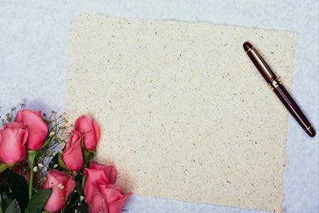
Homework:
-Learn by heart vocabulary
-Prepare Unit 9: Speak.

